Slide 1
Midterm Review
A brief Recap

Slide 2
What have we learned so far?
Software Project Management
Requirement Specification
Software Design

Slide 3
Software Project Management
Activity on Node
Program Evaluation and Review Technique (PERT)
Getting a project back on track (Earned Value Analysis)
Waterfall vs spiral vs UP vs scrum: strengths, weaknesses and differences
Notes:
Image credit: http://horstmann.com/sjsu/summer2012/unit9/diamond.png

Slide 4
Requirements
Requirement types: FURPS
Requirement steps
Analysis
Elicitation
Specification
Domain Model
Usecase diagram
Review the arrows!
Decision Table

Slide 5
Software Design
Class diagram UML
Architecture vs Design
OO programming
Objects
Interfaces
Compile-time vs Run-time
Inheritance
Polymorphism
Grasp

Slide 6


Short answer Questions

Slide 7
Short answer Questions
Notes:
Source: midterm 2013

Slide 8
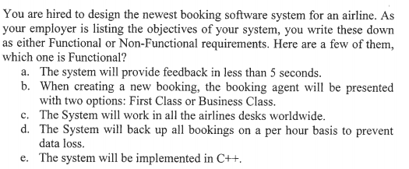
Short answer Questions
Notes:
Source: final 2005

Slide 9

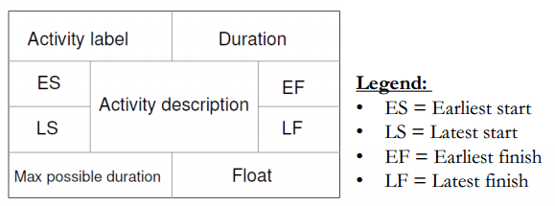
Exercise 1 Activity on Node
Draw the AON diagram
Identify the critical Path
Notes:
Source: fall 2011 final exam

Slide 10
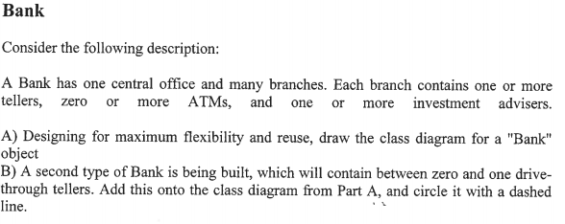
Exercise 2 Class diagram
Notes:
Source: final 2005

Slide 11
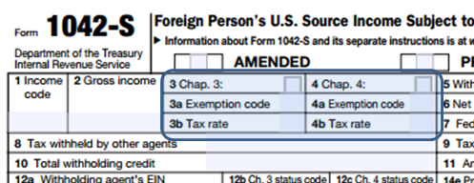
Exercise 3 Decision Table

Slide 12
Exercise 3 Decision Table
General rules:
Rule 1: Only clients with account status “Recalcitrant” are potentially subject to Chapter 4 withholding but may be exempt. All other clients are subject to Chapter 3 withholding, unless the income is exempt from withholding by a tax treaty.
Rule 2: Either Box 3 or Box 4 must be checked (but not both). Boxes 3a, 3b, 4a, 4b must always be filled.

Slide 13
Exercise 3 Decision Table
Rules specific to Boxes 3, 3a, 3b:
Rule 3: All income that is subject to Chapter 3 withholding is reported as follows:
Box 3: Check
Box 3a (Ch3 exemption code): 00
Box 3b (Ch3 tax rate): > 00.00
Rule 4: All income that is subject to Chapter4 withholding is exempt from Chapter 3 withholding and is reported as follows:
Box 3: Uncheck
Box 3a (Ch3 exemption code): 12
Box 3b (Ch3 tax rate): 00.00%
Rule 5: Income that is covered by a tax treaty is exempt from Chapter 3 withholding and is reported as follows:
Box 3: Check
Box 3a (Ch3 exemption code): 02
Box 3b (Ch3 tax rate): 00.00%

Slide 14
Exercise 3 Decision Table
Rules specific to Boxes 4, 4a, 4b:
Rule 6: Any income before July 1 2014 (regardless of the client’s account status and the income type) or income of clients with any status other than “Recalcitrant” is exempted from Chapter 4 withholding and is reported as follows
Box 4: Uncheck
Box 4a (Ch4 exemption code): 15
Box 4b (Ch4 tax rate): 00.00%
Rule 7: All master limited partnership (MLP) income (on or after July 1, 2014) of clients with account status “Recalcitrant” is exempted from ch4 withholding (but may be subject to Chapter 3 withholding) is reported as follows:
Box 4: Uncheck
Box 4a (Ch4 exemption code): 14
Box 4b (Ch4 tax rate): 00.00%

Slide 15
Exercise 3 Decision Table
Rules specific to Boxes 4, 4a, 4b:
Rule 8: All grandfathered income of clients with account status “Recalcitrant” that is not MLP income is exempted from ch4 withholding and is reported as follows:
Box 4: Uncheck
Box 4a (Ch4 exemption code): 13
Box 4b (Ch4 tax rate): 00.00%
Rule 9: For clients with account status “Recalcitrant “, any income that is not subject to rules 6, 7, 8 is subject to chapter 4 withholding and is reported as follows:
Box 4: Check
Box 4a (Ch4 exemption code): 00
Box 4b (Ch4 tax rate): 30.00%

Slide 16
Exercise 3 Decision Table
 | Rules 1,2,5,6 |  | Rules 1,2,3,6 | Rules 1,2,5,6 | Rules 1,2,3,6 | Rules 1,2,5,7 | Rules 1,2,3,7 | Rules 1,2,5,8 | Rules 1,2,3,8 | Rules 1,2,4,9
Conditions:
< July 1 2014 | Y | Y |  | * | * | N | N | N | N | N
Recalcitrant | * | * |  | N | N | Y | Y | Y | Y | Y
Tax Treaty | Y | N |  | Y | N | Y | N | Y | N | *
MLP | * | * |  | * | * | Y | Y | N | N | N
Grandfathered | * | * |  | * | * | * | * | Y | Y | N
Actions
Box 3 | Check | Check |  | Check | Check | Check | Check | Check | Check | Uncheck
Box 3a | 2 | 0 |  | 2 | 0 | 2 | 0 | 2 | 0 | 12
Box 3b | 0.00% | >0% |  | 0.00% | >0% | 0.00% | >0% | 0.00% | >0% | 0.00%
Box 4 | Uncheck | Uncheck |  | Uncheck | Uncheck | Uncheck | Uncheck | Uncheck | Uncheck | Check
Box 4a | 15 | 15 |  | 15 | 15 | 14 | 14 | 13 | 13 | 0
Box 4b | 0.00% | 0.00% |  | 0.00% | 0.00% | 0.00% | 0.00% | 0.00% | 0.00% | 30.00%

Slide 17
Exercise 4 Domain model
Monopoly is a game played on a game board between 2 to six players. The board has 40 squares each of an estate or action. Players have cash and take turns rolling two dice and moving their respective oddly shaped game tokens across the board.
Draw a domain model encapsulating this game.

Slide 18
How to study
Class notes and exercises
Tutorial exercises

Slide 19
References

